Slide 1
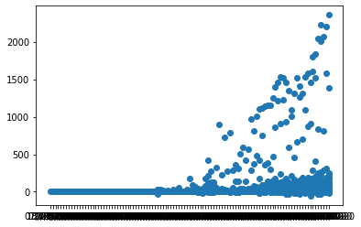
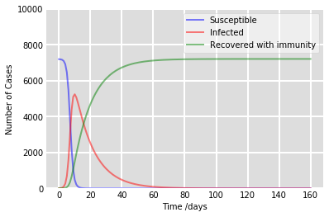
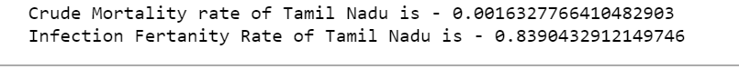
Analysis of the Spread of Covid-19 In Tamil Nadu and India
A) The graph above depicts the data points of the cases in Tamil Nadu from 30th January to 10th July.
After modelling the time series, we observe that cases in Tamil Nadu will hit its peak in the next 20 days before the curve starts to flatten(if and only if the rate of transmission remains the same as on 9th July 2020)

Slide 2
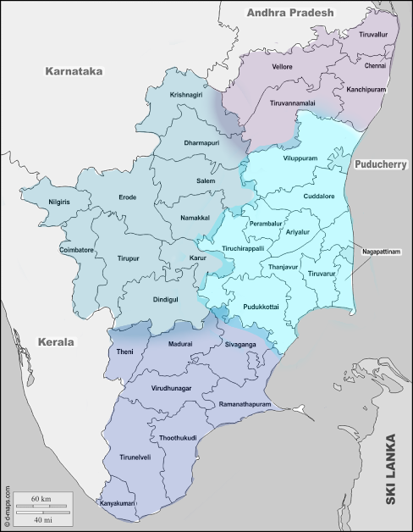
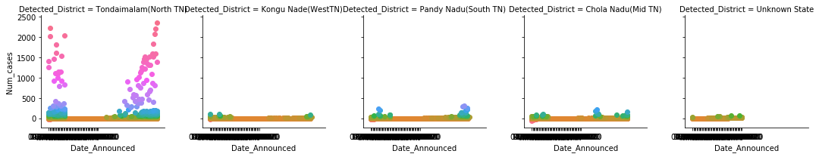
A) District-wise Spread of covid-19
The cases in TN belong to 38 Districts, which have been grouped into 4 zones-
1)North of TN -Tondaimandalam.
2)West of TN -Kongu Nadu
3)South of TN - Pandy Nadu,
4)Mid of TN - Chola Nadu
The highest recorded cases of the state originate from Tondaimandalam, where the capital city Chennai is situated.
Minimal cases are recorded from the rest of zones

Slide 3
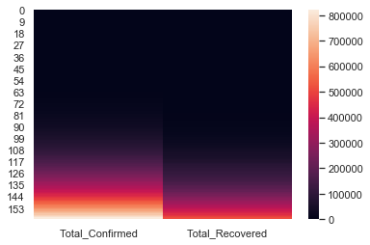
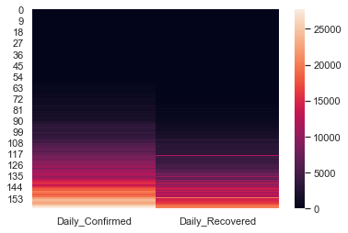
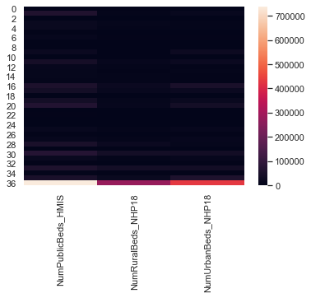
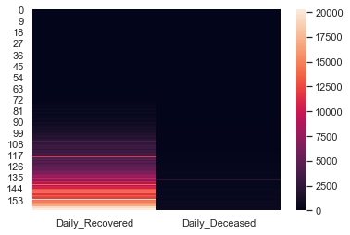
B) HEAT-MAPS OF THE CASES IN INDIA(30TH JAN-10TH JULY)
Total Confirmed v/s Recovered
Daily Confirmed v/s Recovered
Number of beds in Public v/s Rural v/s Urban Hospitals
The range of the number of beds is 10,000 - 200,000 beds
Daily Recovered v/s Deceased

Slide 4
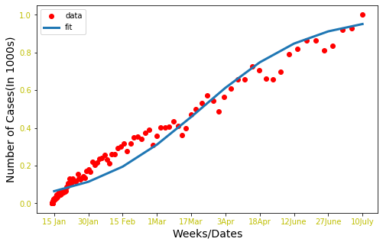
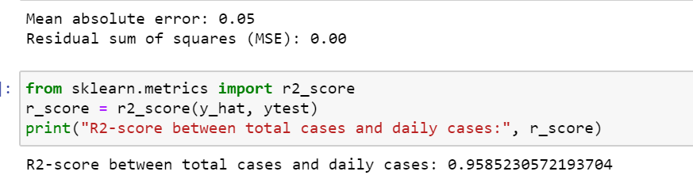
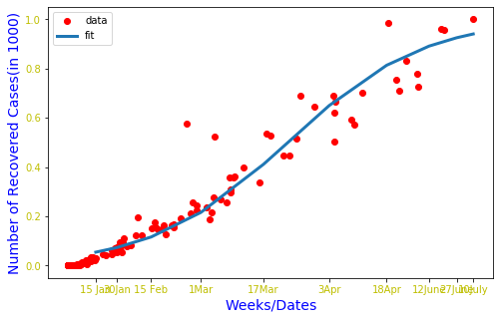
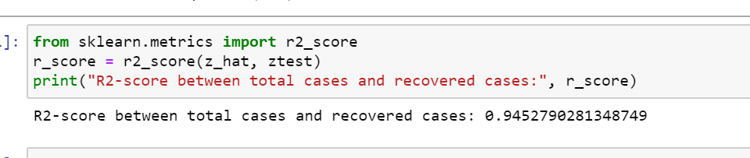
C1)Fitting & predicting total number
of recovered and daily cases in india
using Polynomial regression
The fitted data is plotted against the original cases, yielding an R2 score >90%.

Slide 5
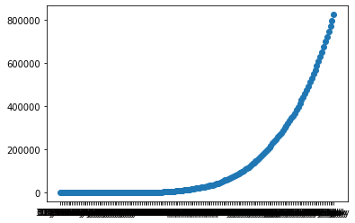
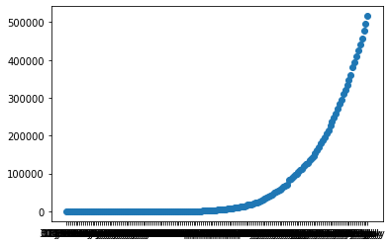
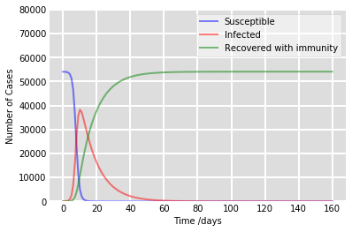
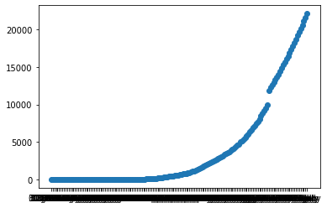
C2) Predicting total cases using SIR model
The graphs on the left are plotted using the data available since 30th January; the curve has been rising rapidly since mid-April.
The model below is built using beta = 1.19, gamma = 1/10, initial values taken from the data on 9th July. Based on these values, the curve should start to flatten in the next 50 days.
Total Cases
Recovered Cases
Deceased Cases

Slide 6
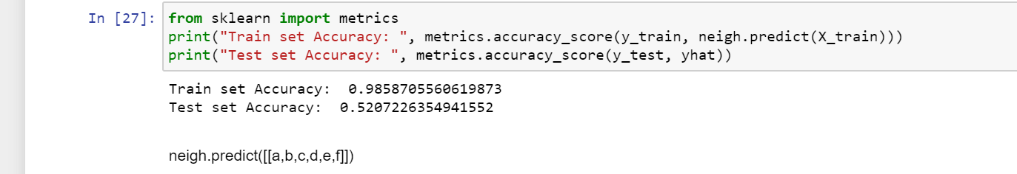
D) Building a classifier for severity gauging
Built a model using classifiers to predict if a person with known symptoms is suffering from Covid-19, or the Flu.
Data Source(s) -
https://api.covid19india.org/csv/
https://www.kaggle.com/sudalairajkumar/covid19-in-india
By,
Chandan Tanvi
Department of Statistics(LPU)
12 - 07 - 2020

